Slide 1
Community Participation in Project Implementation
A Refresher Training for AI Officers at Kwale sub-County Offices, Lunga Lunga 26Th August 2026

Slide 2

Definition
Community participation is the active involvement of local people in planning, deciding, and acting on issues that affect their daily lives. It builds local ownership, strengthens self-reliance, and makes public projects more successful.

Slide 3
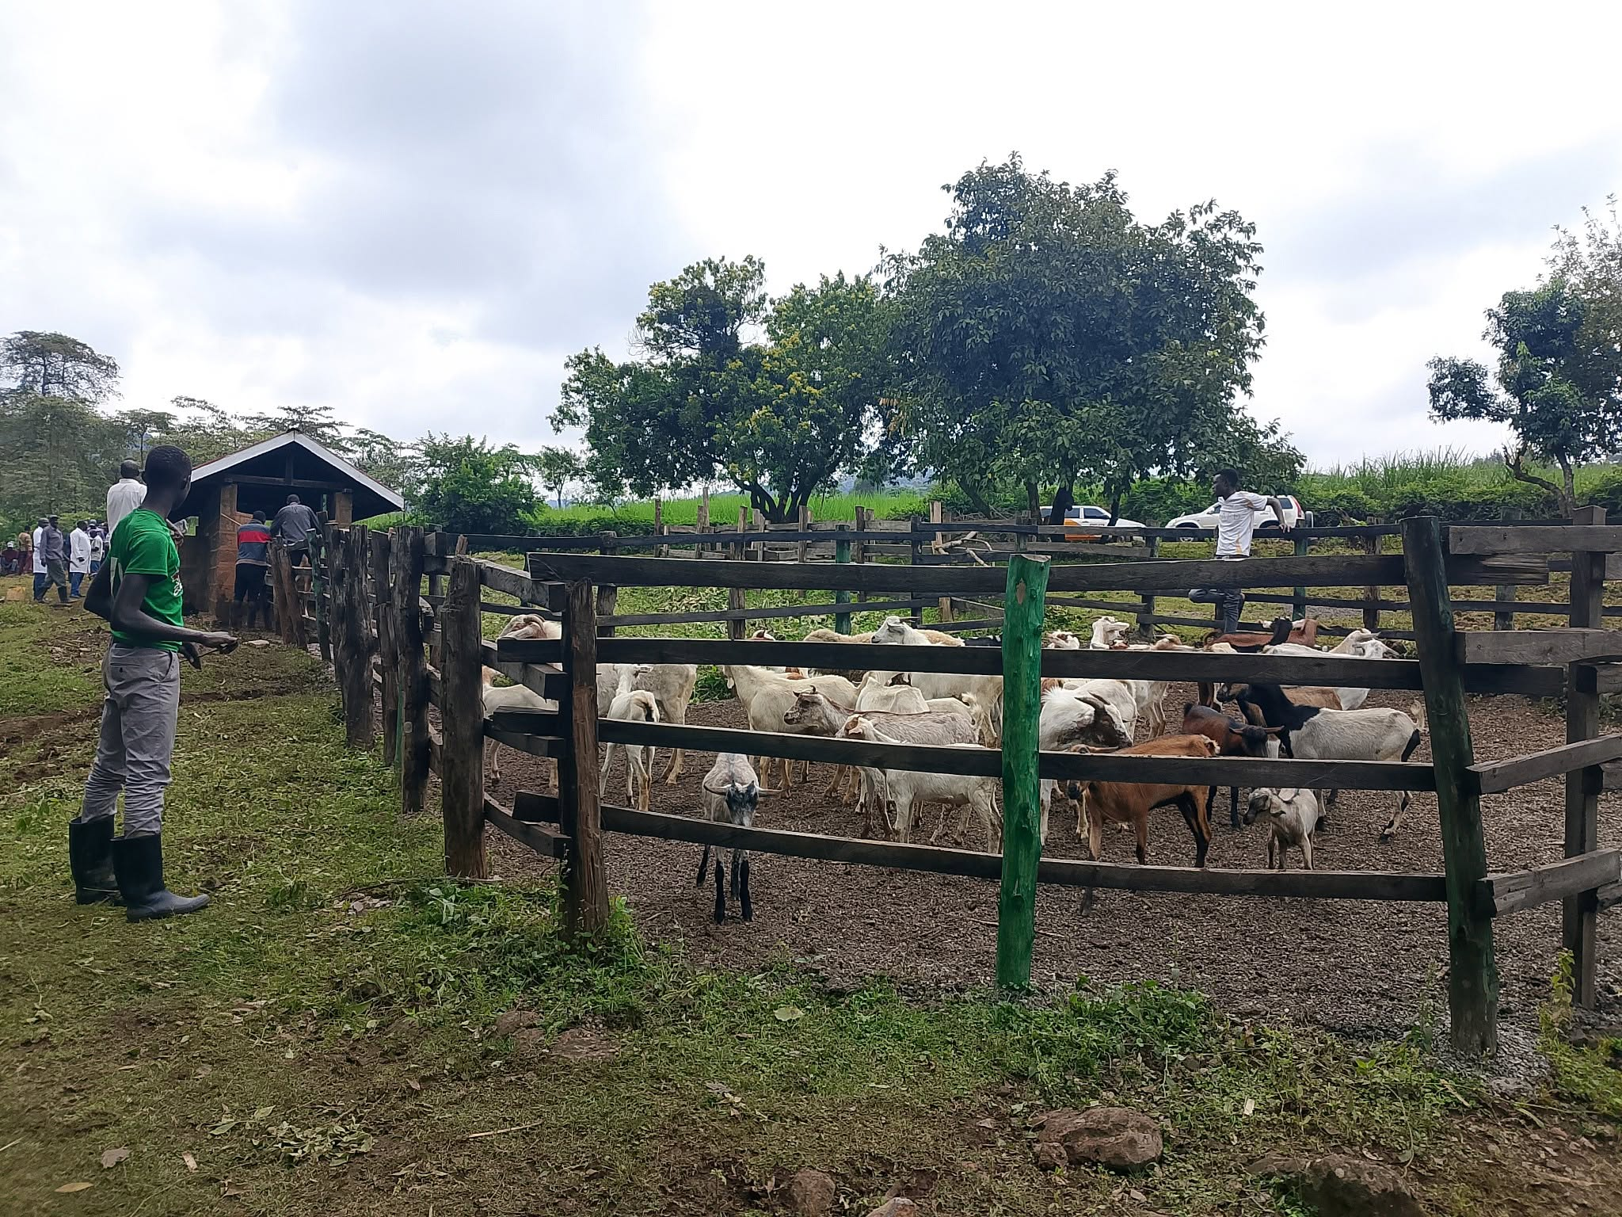
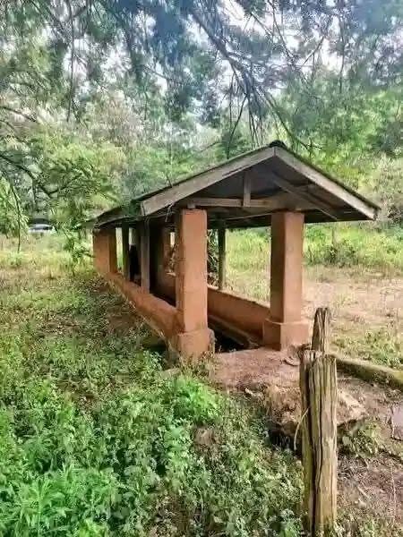
Concept of Community Participation
The concept of community participation came into being as a response to developmental challenges in the advent of officially generated “logical” responses to encountered problems e.g. Construction of cattle dips to control ectoparasites in livestock

Slide 4
Levels of Participation
Passive
People are only told what has been decided or done.
ii . Consultative
People answer questions, but have no real decision-making power.
iii. Interactive
People work together with others to analyze problems and make joint plans.
iv. Self-Mobilization
People take independent action and lead their own initiatives

Slide 5
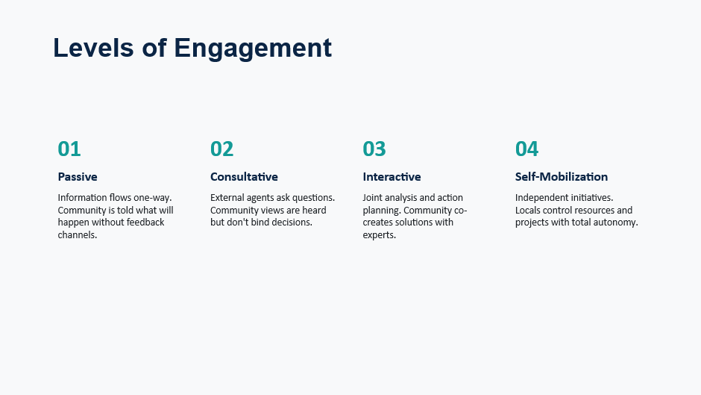

Slide 6
Current Situation in Our Communities
Currently, a lot of decision-making power to provision of solutions to problems affecting communities still lie in the hands of donors, NGOs and governments e.g. which projects to undertake and which ones not to.
Therefore, there is need to change power relations within the sector to empower communities to come up with their own projects and ideas that they believe are valuable and important.

Slide 7
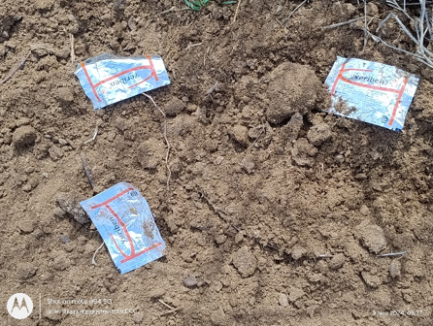
Current Situation Cont’d
In communities we see individual families attempt to solve problems e.g. herd and disease management, use of technologies to control diseases etc
There is also an element to community participation eg. Running cattle dips

Slide 8
Importance of Community Participation
Enables communities to come up with solutions/programs to address their real local needs.
People gain skills and confidence to deal with local challenges in realization that they can address and solve their own problems.
Community participation promotes ownership and sustainability of projects

Slide 9
How to Enhance Community Participation
Look first at what the people have and can do themselves and, if necessary, and give support. When community members become the co-owners of projects, project sustainability is more likely.
Leverage community resources and structures e.g. women groups, gender etc.
Generate change agents from the community i.e. establish a ToT base in the community for enhanced knowledge base
In your interaction with community members, treat them with respect and do not assume a higher position

Slide 10
Factors that may Hinder Effective Community Participation in Projects
Implementing agencies/officers taking a commanding role in project activities
When the community perceives implementers as lacking respect to members
Lack of understanding of the community’s social structure by the project implementing team.

Slide 11
Participation Hinderances Cont’d
Historical factors e.g. death of treated animals
Negative occurrences after project implementation e.g. observed SIT release
Implementers not having full understanding of social values of the target communities e.g. non-sharing of livestock

Slide 12

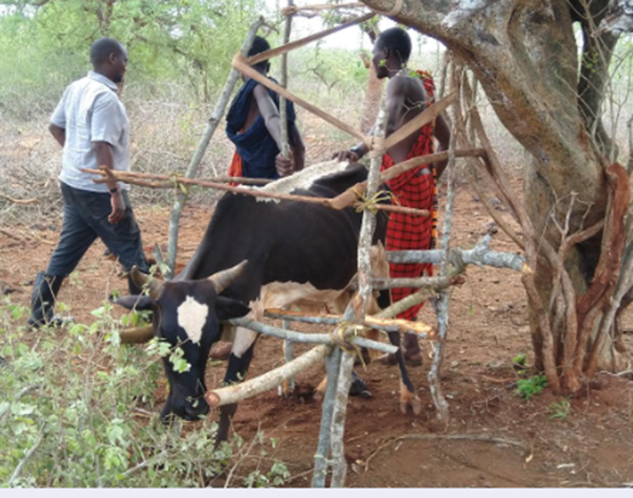
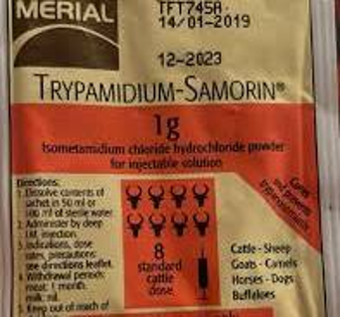
Participation Hinderances Cont’d
Pink Eye event in Laisamis, Marsabit (after treatment of donkeys with Samorin®)
2021 Drought in Kwale’s Mwereni after FTAI activities

Slide 13
Conclusion
Community participation is more than just participating; it is the key to meaningful change.
Direct involvement of people in projects, from problem identification to solution, not only realizes a project that meets the concerns and priorities of the community, but also creates local ownership and sustainability

Slide 14
END

