Slide 1

CAPACITY BUILDING FOR JOB CREATION AND GROWTH OF LEATHER GOODS AND FOOTWEAR MANUFACTURING ENTERPRISES IN KENYA
LEATHER VALUE CHAIN
NOVEMBER 19TH, 2025
DR. PAUL TANUI
D
Y
E
G
D
AN
O
IV T
L
K
IM
AT
HI
UN
ERSI
Y O
F T
EC
H
NO
Dedan Kimathi University of Technology

Slide 2

Preamble: Kenyan Government Priority Areas
Six core pillars of Kenya Kwanza government’s BETA:
Agriculture
Micro, Small and Medium Enterprise (MSME) economy
Housing and Settlement
Healthcare
Digital superhighway and creative economy
Environment and climate change
Budget Watch 2023_0.pdf (parliament.go.ke)

Slide 3
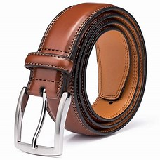

Cont’
In 2023/2024 FY, GoK planned to support manufacturing and raise its GDP contribution from 7.2% in 2021 to 15% by 2027
In 2022, manufacturing contributed 7.8% of GDP
Leather sector contributes about 4% of agricultural GDP & 1.5% of overall GDP
Kenya is set to employ over 100,000 people in leather sector by 2027
Kenya plans to ban the importation of shoes by 2027 to support local production
question mark - Search Images

Slide 4
CAPACITY BUILDING FOR JOB CREATION AND GROWTH OF LEATHER GOODS AND FOOTWEAR MANUFACTURING ENTERPRISES IN KENYA
D
Y
E
G
D
AN
O
IV T
L
K
IM
AT
HI
UN
ERSI
Y O
F T
EC
H
NO
Dedan Kimathi University of Technology

Slide 5
Goal and objectives of the Workshop
Goal:
The goal of this project is to provide a structured way of upgrading the skills of the players involved in the production of leather goods and footwear in Kenya.
Specific objectives:
To conduct baseline survey on the status of production and capacity gaps of leather goods and footwear by MSMEs in Kenya.
To provide a structured training to youth and women-based MSMEs involved in the production of leather goods and footwear from selected counties in Kenya.
To promote learning culture among the players involved in the production of leather goods and footwear in Kenya.

Slide 6

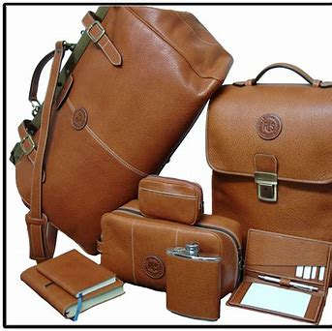
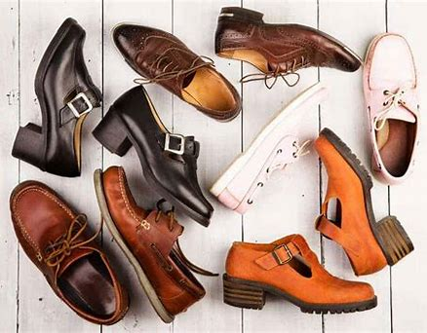
Training phases
Survey on footwear and leather goods manufacture (five counties)
Recruitment of trainees
Phase I training (theory)
Phase II (leather goods)
Phase III (Footwear)

Slide 7
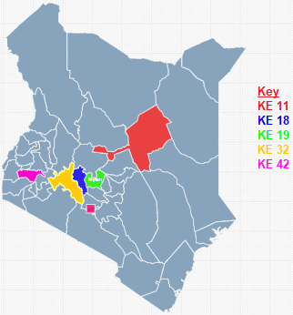
Survey – Participating Counties
Five selected counties:
Isiolo
Nyeri
Nyandarua
Nakuru
Kisumu

Slide 8

Number of participants
Total per County:
Isiolo 18
Nyeri 20
Nyandarua 19
Nakuru 21
Kisumu 20
Distribution per County
County | Gender (%)
 | Male | Female
Nyeri | 65% | 35%
Kisumu | 75% | 25%
Isiolo | 44% | 56%
Nyandarua | 100% | 0%
Nakuru | 95% | 5%

Slide 9
Distribution by ability
a) Distribution per County
b)
County | Disability status (%)
 | Yes | No
Nyeri | 15% | 85%
Kisumu | 10% | 90%
Isiolo | 0% | 100%
Nyandarua | 16% | 84%
Nakuru | 0% | 100%
Nine (9)% abled different

Slide 10
Nature of MSMEs
Majority of leatherworkers are small-scale manufacturers
Isiolo tops with 83.3%
Nyeri comes in second with 80%
Nakuru is third with 71.4%

Slide 11
Training manual
Provides a detailed account of the topics covered
Material can be used to train others at place of work (ToTs)

Slide 12
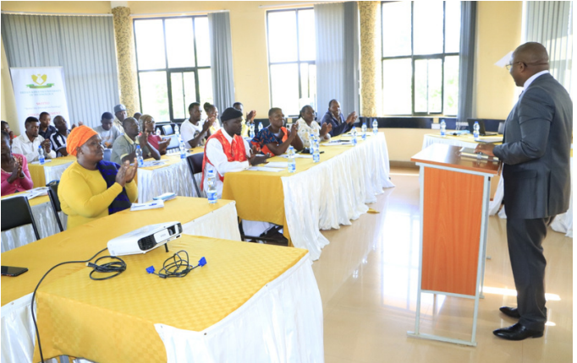
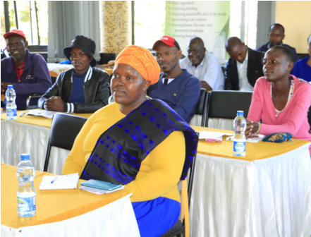
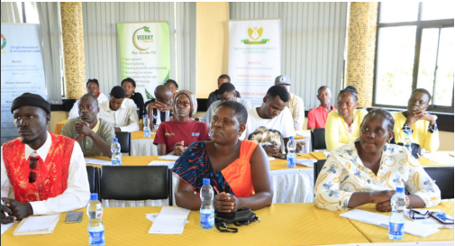
Training sessions- Phase I (DeKUT)- Theoretical

Slide 13
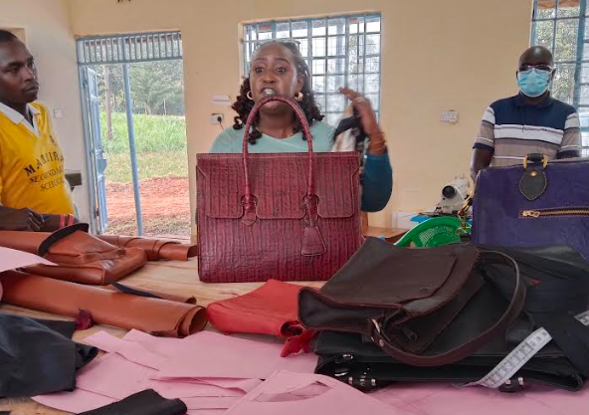
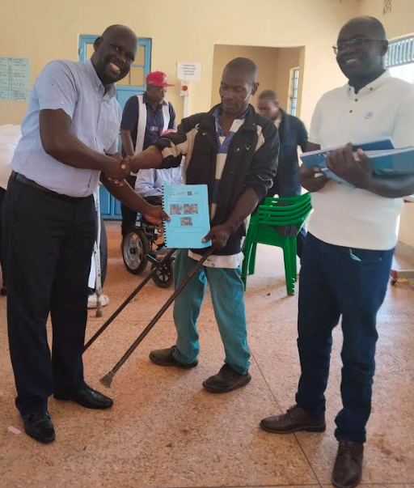
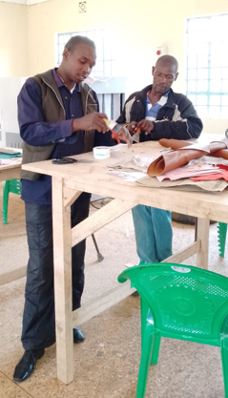
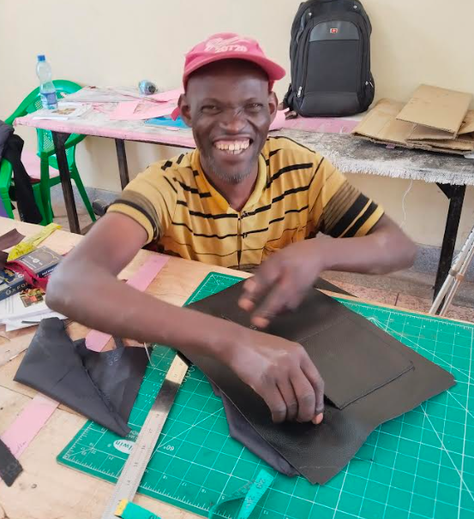
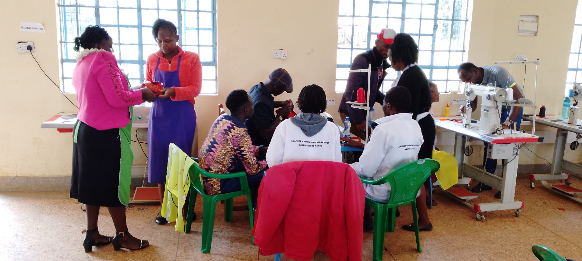
Training sessions- Phase II (Rukira VTC)- Leather goods

Slide 14
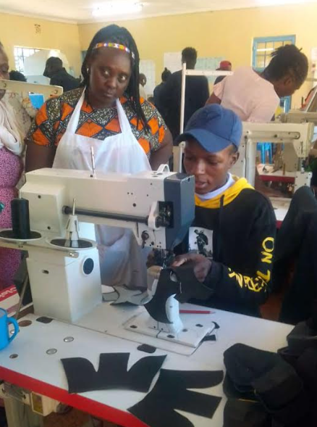
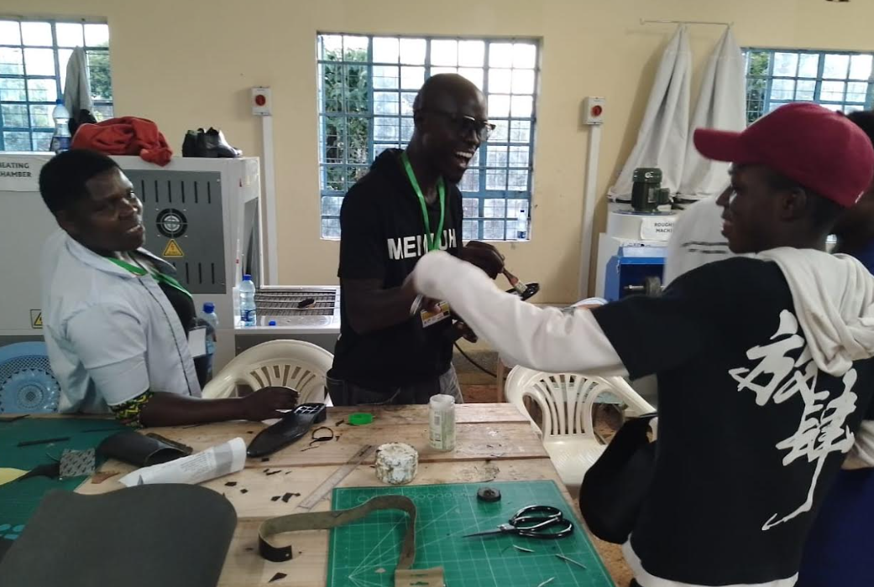
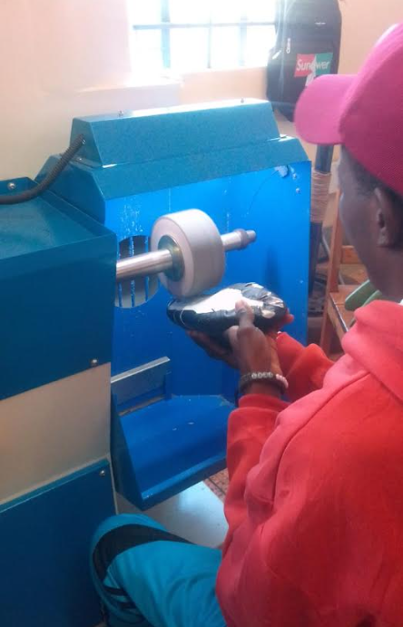
Training sessions- Phase III (Rukira VTC)- Footwear

Slide 15
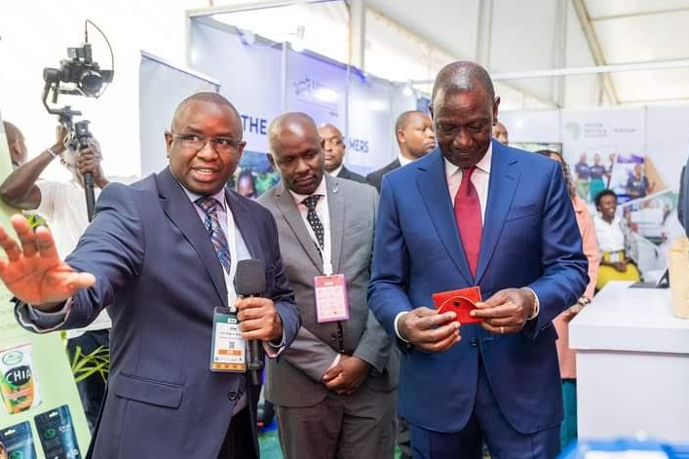
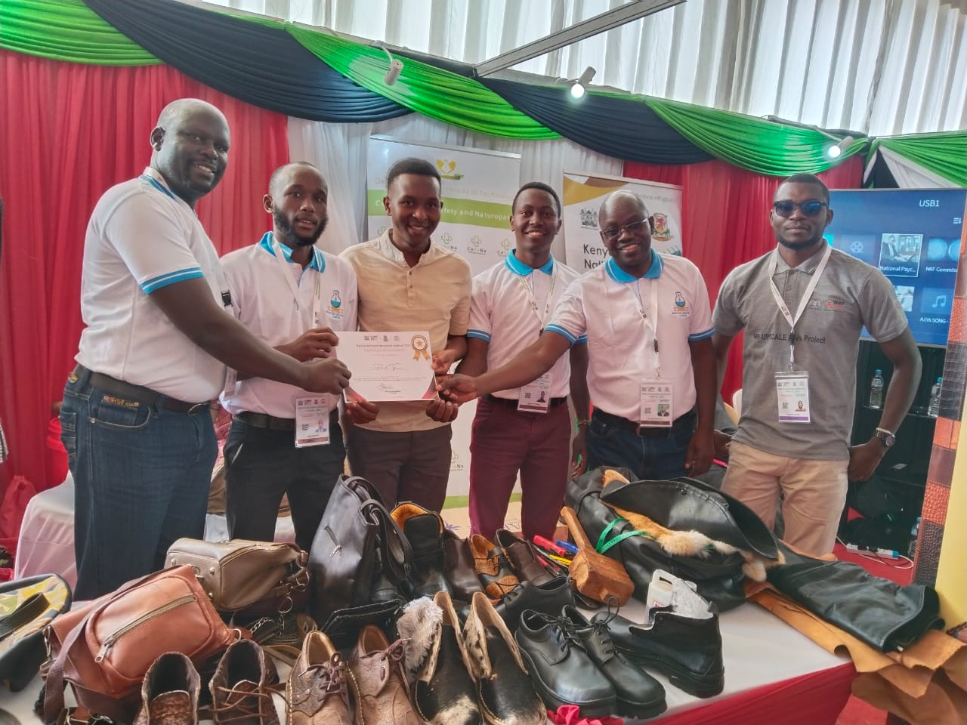
Conference and Workshop Presentations

Slide 16
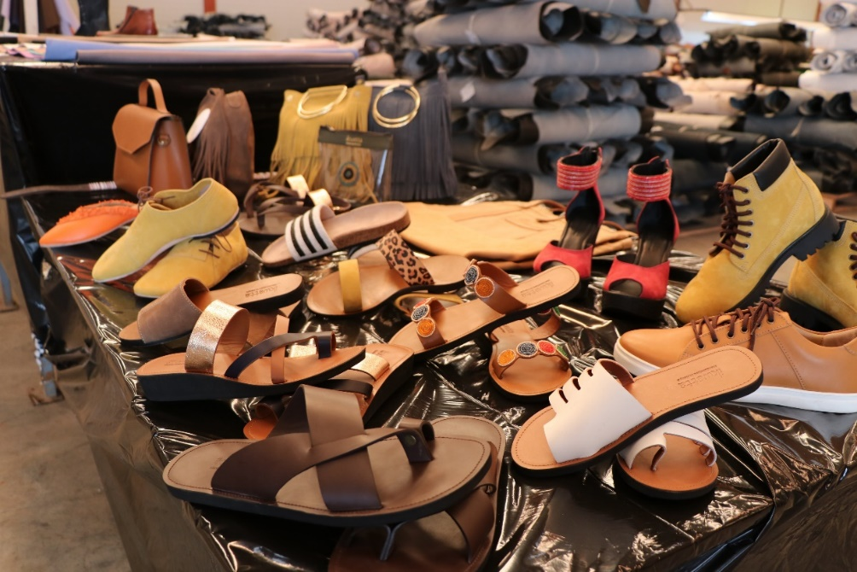
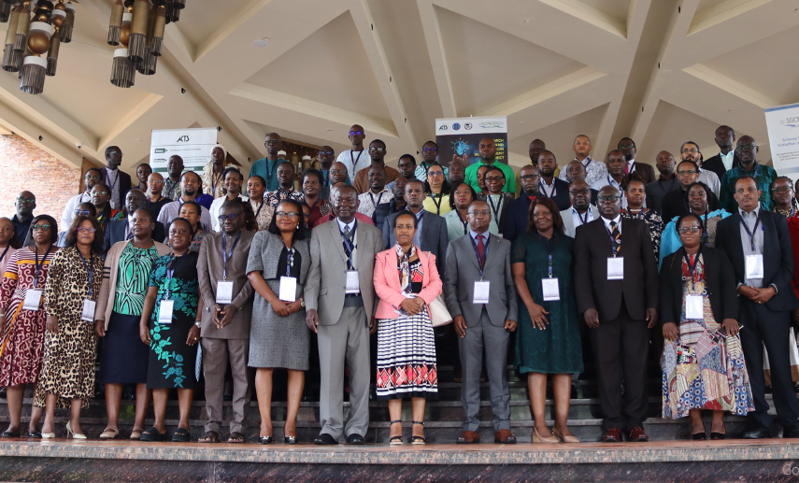


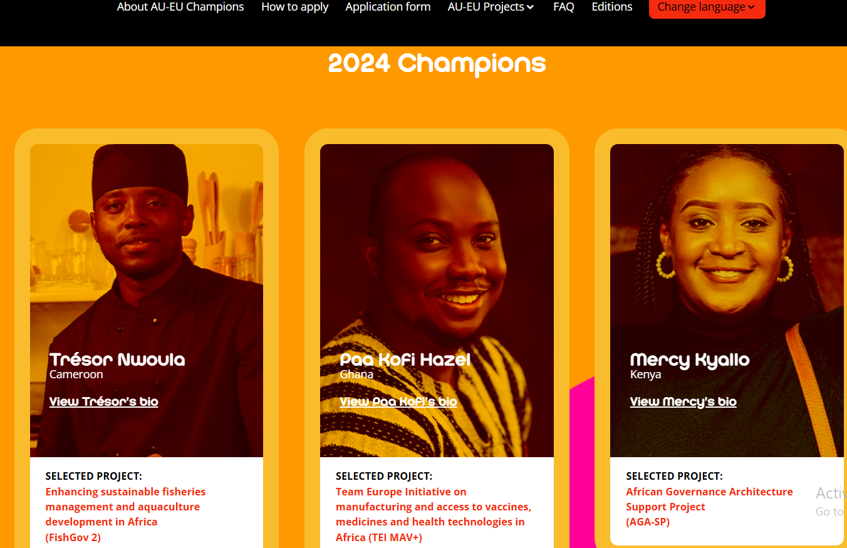
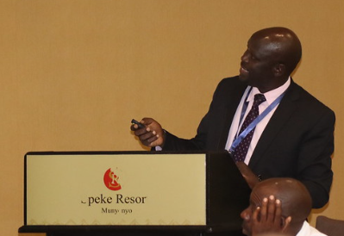
Consortium milestones
Alpharama Ltd in need of >50 experts for hire……
RIM Annual Symposium- Kampala, Uganda
Addis Ababa, Ethiopia Conference

Slide 17
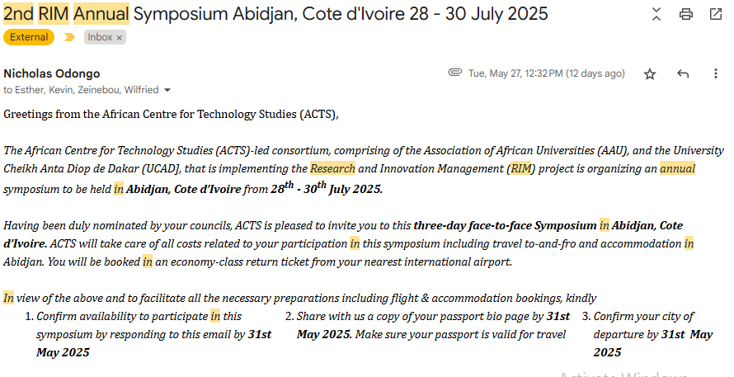
Consortium milestones (Cont’)
2nd RIM Annual Symposium- Abidjan, Cote d’Ivoire
28th – 30th July 2025

Slide 18
Lessons learned
Key lessons from the survey:
Counties with organised groups access leather at fair prices
Access to information on financing remains a significant challenge in all counties
Capacity building for PLWDs and women is affected by among other factors the availability of training facilities and role played at home
Only one county has collaborated with a training institution as a way of support leatherwork

Slide 19
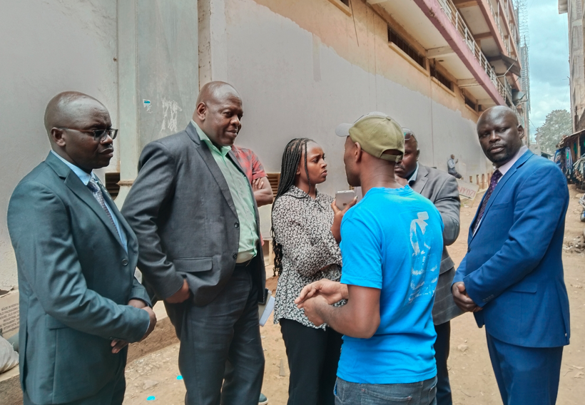
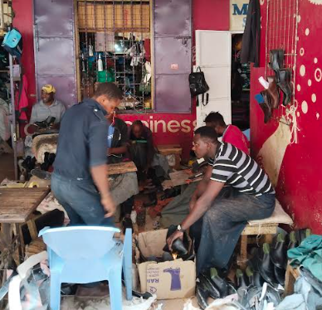
NRF-ACTS Monitoring & Evaluation Process
MSMEs have pushed their production from <10 to >15 pairs of shoes per day
Product diversification

Slide 20
The Future…
Key steps towards success in the leather sector:
There is still need for further capacity building to other counties.
Support Government initiative for common manufacturing facilities and common effluent treatment systems.
A huge opportunity lies in growing the sector with the Kenyan, EAC, COMESA, European and American markets in a duty free, quota free arrangement.

Slide 21
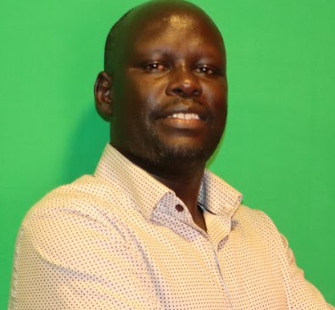
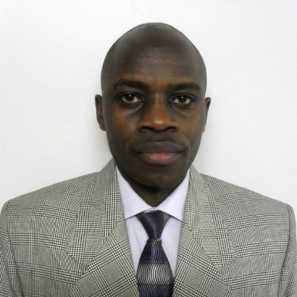

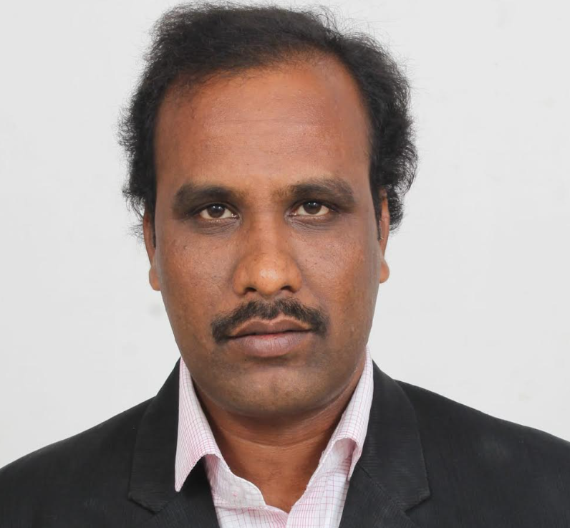
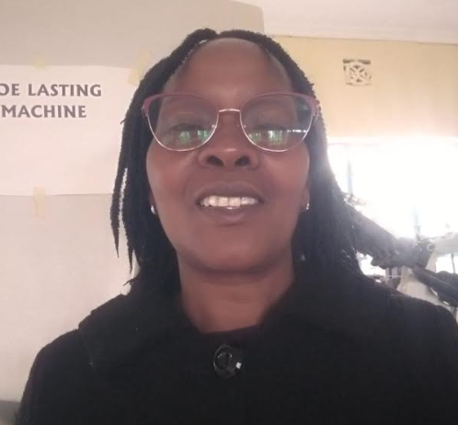
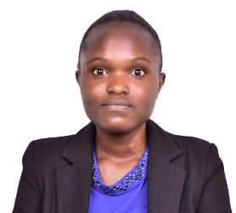
Consortium members
Dr. Paul Tanui
Principal Investigator- DeKUT
Dr. Benson Ongarora
Project Coordinator- DeKUT
Ms. Mercy Kyalo
Industry Partner- Yallo Ltd
Mr. Raja Kannan
Trainer- DeKUT
Ms. Consolata Wangari
Trainer- Rukita VTC
Ms. Louret Atsenga
Mentee- Eldoret Nat Poly.

Slide 22







Acknowledgements

Slide 23
THANK YOU
Private Bag- Dedan kimathi, Nyeri-Mweiga road
Telephone: +254-061 2050000 Email: vc@dkut.ac.ke Website: www.dkut.ac.ke
D
Y
E
G
D
AN
O
IV T
L
K
IM
AT
HI
UN
ERSI
Y O
F T
EC
H
NO
Dedan Kimathi University of Technology

