Slide 1

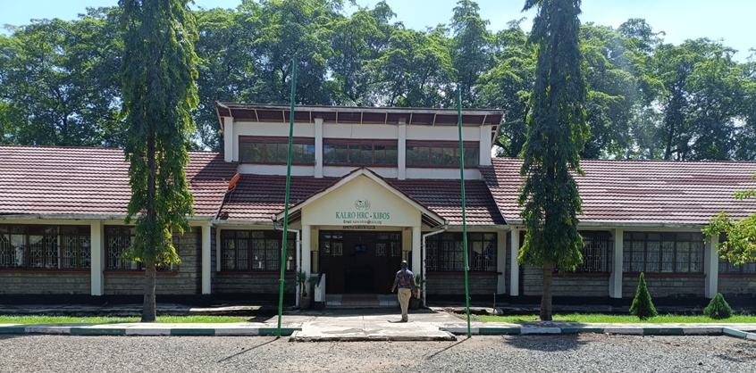
Horticulture Research Centre: Kibos
Presentation to NRF on 24th June, 2025 at KALRO HRC Kibos
Timon K. Moi - Centre Director

Slide 2

Rationale/Mandate of the Centre
Undertake research in all aspects of production, management, postharvest and value addition of Horticultural, Food & Industrial crops.
The outputs from research activities implemented are to support the national Horticultural, Food & Industrial crops industry.
The research programmes respond to sector specific value chains in cotton, rice, fruits, vegetables, roots & tubers, millets, sorghum and other horticultural crops (medicinal plants).

Slide 3
Centre’s Strategic Direction
Vision:
Excellence in horticultural, food and industrial crops research towards transformed livelihoods.
Mission:
To conduct horticultural, food and industrial crops research through application of science, technology and innovation to catalyze sustainable growth and development in horticulture, food and industrial crops Product Value Chains.

Slide 4
Centre’s Key Results Areas
KRA 1: Technologies and innovations for horticultural, food and industrial products value chains generated
KRA 2: Knowledge, information and technologies on horticultural, food and industrial value chains collated, stored and shared
KRA 3: Socio-economics information, market and policy options supporting horticultural, food and industrial product value chains generated and advocated
KRA 4: Institutional capacities and resource management strengthened
KRA 5: Systems for coordination, prioritization and regulation of horticultural, food and industrial product value chains developed and operationalized

Slide 5
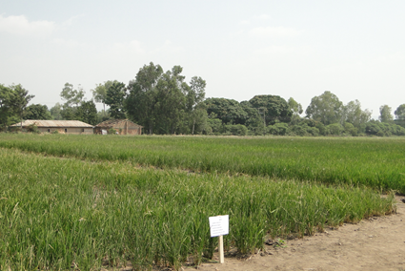
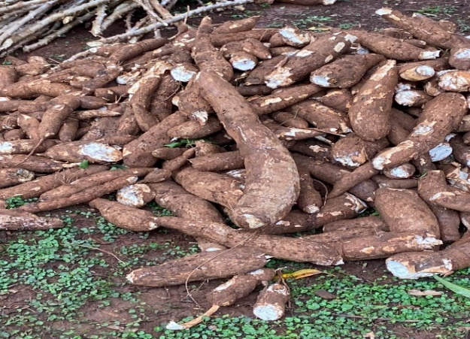
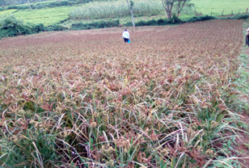
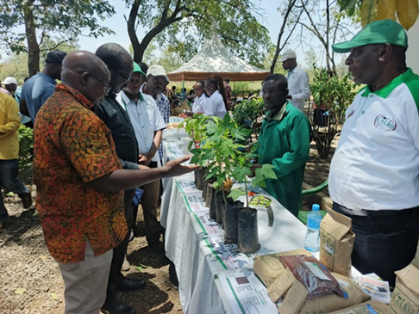

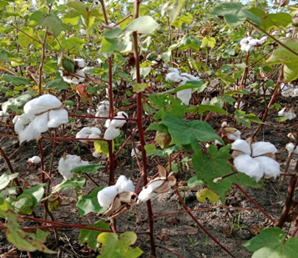
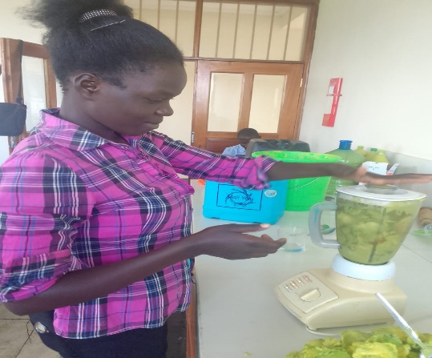
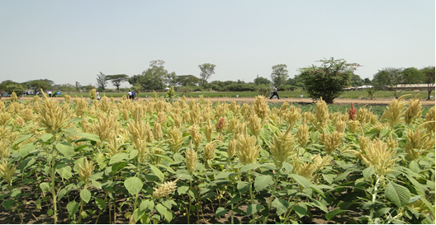
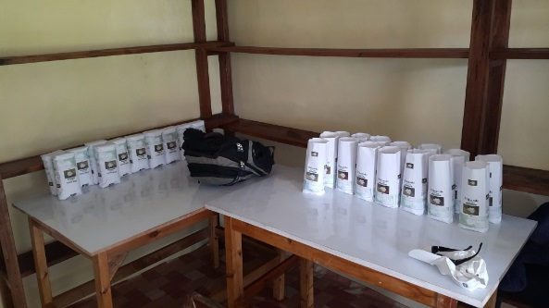

Thematic Research Areas
Cotton
Rice
Millets
Sorghum
Maize
Vegetables & Fruits
Roots & Tubers
Crop Improvement and Health
Postharvest/Value addition
Socio-Economics & Applied Statistics
Natural Resource Management

Slide 6
Thank You

