Slide 1





Upscaling African Indigenous Vegetables Climate Smart Technologies for Food & Nutrition security in Kenya
NRF-M&E IN WESTERN KENYA AT MMUST ON 27th NOVEMBER 2025

Slide 2

Members of the Team
No. | Name | Institution | Role
1. | Prof Mary Abukutsa-Onyango | JKUAT | PI, Objective 1,2
2. | Prof Anselimo Makokha | JKUAT | Co-Objective 5
3. | Dr Eucabeth Majiwa | JKUAT | Marketing, M&E
4. | Mr Patrick Amunavi | JKUAT | Objective 6 Lead
5. | Ms Joyce Liti Njenga | JKUAT | BSF expert
6. | Mr James Shikwati | IREN-Growth Pad | Objective 4 Lead
7. | Ms. Esperance Chesoli | IREN-Growth Pad | Processing & Marketing
8. | Mr Muchiri Nyaggah | LDRI | Technology transfer
9. | Ms. Judith Mumba | LDRI | Mobilizer & M&E
10. | Dr Anne Aswani | MMUST | Objective 3 Lead

Slide 3
General Project Details
NRF-Special call on Upscaling technologies through PPP
Thematic area: Food and Nutrition Security
Lead institution: JKUAT
Duration: 18 months
Period: November 2023 to May 2025
Counties : Kakamega and Kiambu
AIVs: Managu and murenda
Four institutions (2 public & 2 private)
Project Budget : KES 15,000,000/=

Slide 4
Background
30 Vegetable crops grown in Kenya 25% are AIVs including: Kunde, managu, terere, sagaa, , mrenda, mitoo etc
Grown in 50% of the 47 counties
300,000 MT AIVs produced, valued at 10B KES in 2023 (5% for Export 0.5B)
The Demand of AIVs not met

Slide 5

Productivity of AIVs 2023
AIVs | ^{MT/HA} | ^{POTENTIAL}
Vegetable Cowpea (Kunde) | 3.2 | 20-30
African nightshade (Managu) | 10.0 | 30-40
Vegetable amaranths (Terere) | 11.8 | 30-40
Spiderplant (Sagaa) | 9.7 | 30-40
Jute mallow (mrenda) | 5.1 | 20-30
Slender leaf (mitoo) | 6.7 | 20-30
1. 2011 to 2025 Production (tons ) increased by 200%
2.Current Production: 300,000 MT Current value: 10B KES

Slide 6
Rationale
High Food and nutrition insecurity in Kenya due to adverse climate change effects
Unexploited High value AIVs
Several Developed technologies unutilized
Registered varieties of AIVs
Organic sources of fertilizer like Frass fertilizer from BFS underutilized
High Perishability of AIVs
Untapped potential of Public/Private sector collaboration.

Slide 7
Goal & overall Objective
Goal:
To contribute to achieving food and nutrition security in the context of climate change challenges facing Kenya by promoting the sustainable production, commercialization and utilization of African Indigenous Vegetables (AIVs).
Overall Objective:
To upscale the production, preservation and utilization technologies of African indigenous vegetables for food and nutrition Security in Kenya.

Slide 8
6 Specific Objectives
i. To assess farmer acceptability of registered two African Nightshade and two Jute Mallow varieties, in Kakamega and Kiambu Counties.
ii. To upscale the production of African nightshade and Jute mallow in Kakamega and Kiambu counties using climate smart technologies and registered varieties.
iii. To promote the use of standardized recipes of African nightshade and Jute mallow in selected institutions in Kakamega and Kiambu counties.

Slide 9
6 Specific Objectives
iv. To promote the commercialization of African nightshade and Jute mallow in Kakamega and Kiambu counties.
v. To promote the use of preservation and value addition technologies of African nightshade and Jute mallow in Kakamega and Kiambu counties.
vi. To Repackage technical information, disseminate, train, and promote African nightshade, Jute mallow and other priority AIVs using diversified platforms.

Slide 10
Expected Outputs
i) Farmer acceptability of registered two African nightshade and two Jute mallow varieties in Kakamega and Kiambu counties assessed.
ii.) The production of African nightshade and Jute mallow in Kakamega and Kiambu counties using climate smart technologies and registered varieties upscaled.
iii.) The use of Standardized recipes of African nightshades and Jute mallow in selected institutions in Kakamega and Kiambu counties promoted and upscaled.

Slide 11
Expected outputs
iv.) The Commercialization of priority African nightshade and Jute mallow in Kakamega and Kiambu counties promoted.
v. The use of preservation and value addition technologies, specifically solar drying of African nightshade and Jute mallow in Kakamega and Kiambu counties upscaled.
vi.) Technical information repackaged, disseminated, training conducted and African nightshade, Jute mallow and other key priority AIVs promoted using diversified platforms.

Slide 12

AIVs Released by KEPHIS
Variety name | Release name | Licensee
1. African nightshade -1 | Abuku Mnavu -1 | Abukutsa
2. African nightshade -2 | Abuku Mnavu - 2 | Abukutsa
3. African nightshade -3 | Abuku Mnavu - 3 | Abukutsa
4. Vine Spinach – 1 | Abuku Nderema -1 | Abukutsa
5. Vine Spinach - 2 | Abuku Nderema -2 | Abukutsa
6. Jute mallow -1 | Abuku Mrenda-1 | Abukutsa
7. Jute mallow -2 | Abuku Mrenda-2 | Abukutsa
8. Spiderplant-1 | Abuku Sagaa-1 | Abukutsa
9. Spiderplant - 2 | Abuku Sagaa-2 | Abukutsa

Slide 13
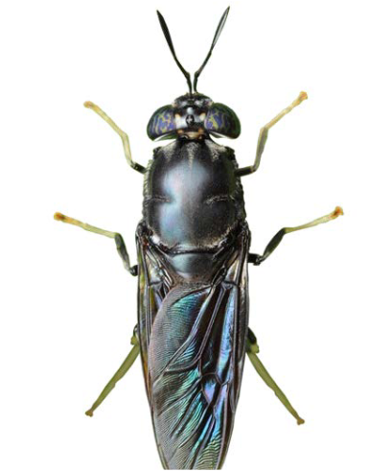
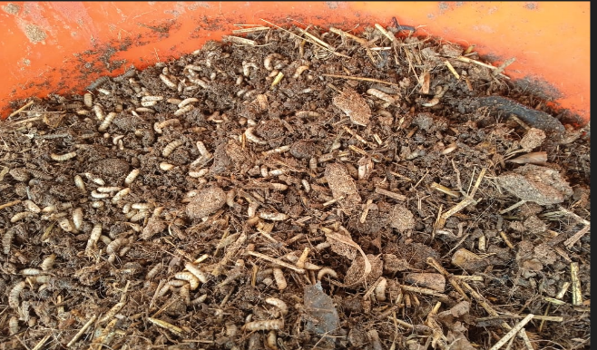
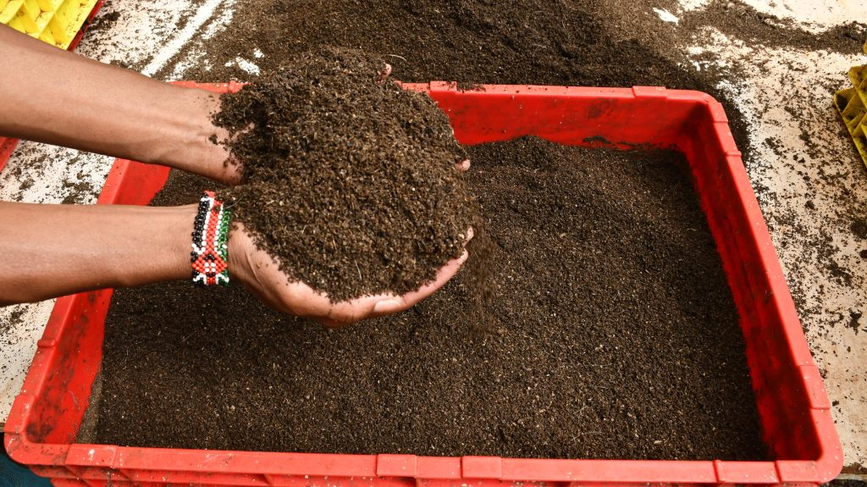
Black Soldier Fly (BSF)

Slide 14
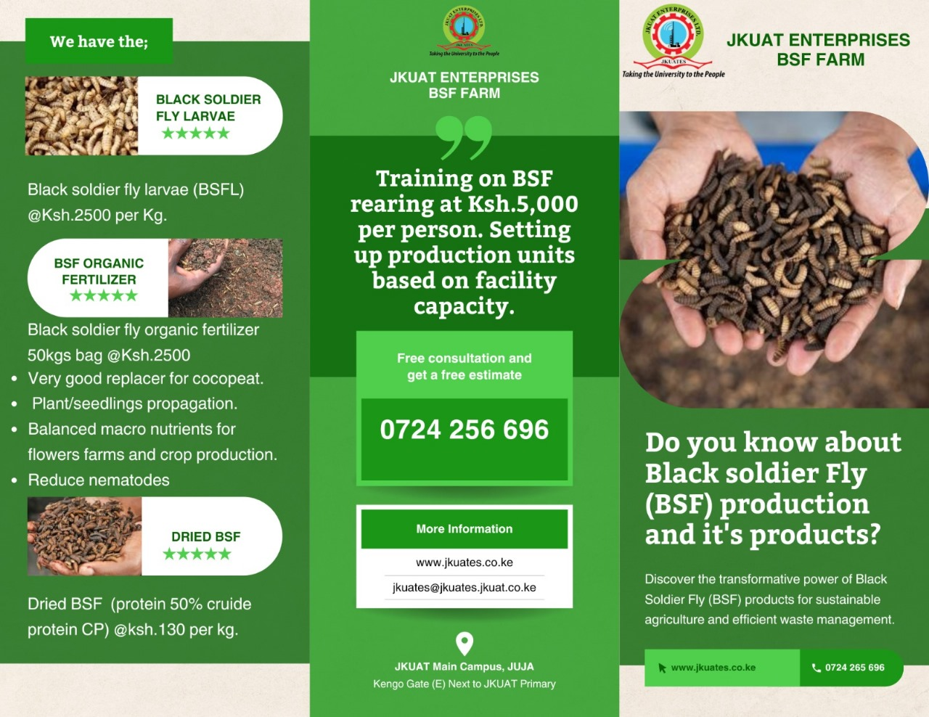
Black Soldier Fly (BSF)

Slide 15
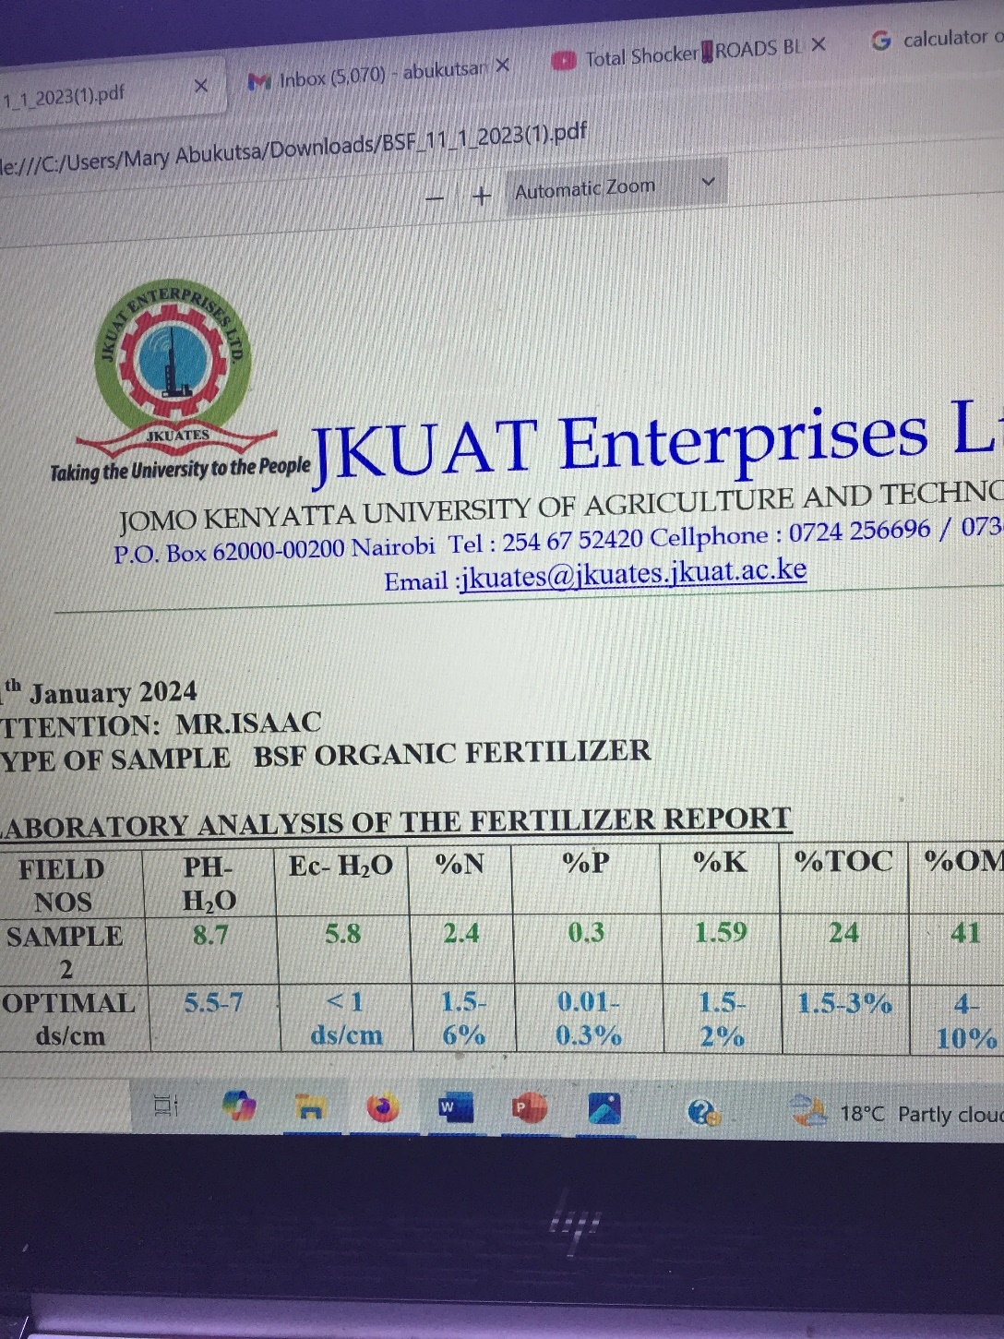
Frass fertiliser (BSF)

Slide 16
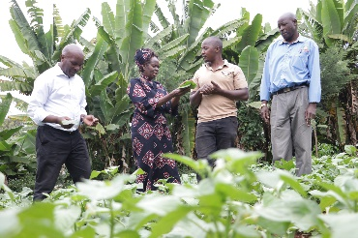
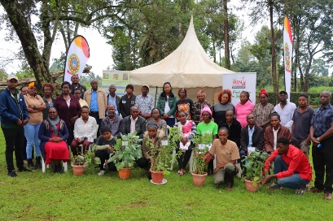
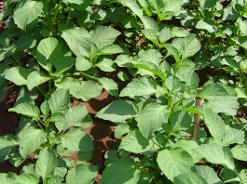
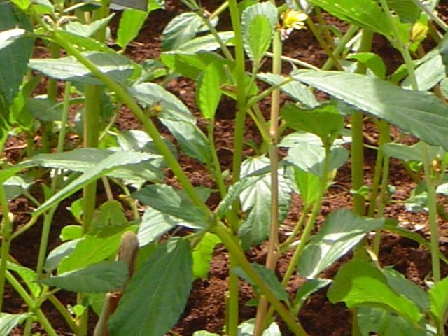
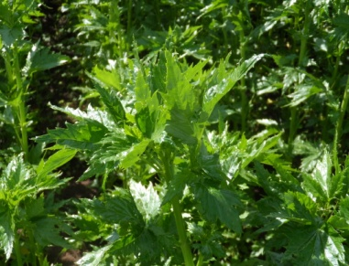
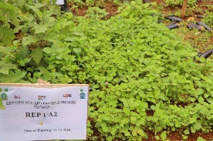
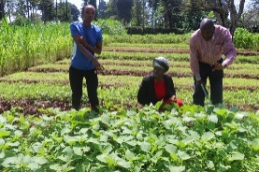
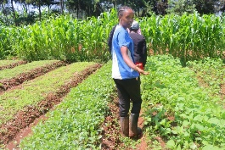
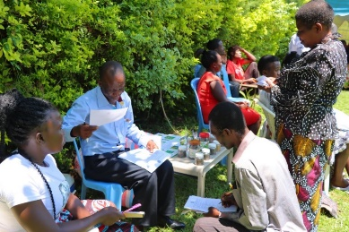
Objective 1 Outputs
1.1 identified and sensitized 300 farmers in Kiambu & Kakamega Counties | 1.1 List of identified farmers
1.2 Set up demonstrations (10m x 10m) in FFS in Githunguri (Wing farm) and Lurambi (Machoni Farm) on farmers seed and new variety tests for African nightshade and Jute mallow | 1.2 Activity based reports Field set up and design
1.2 Trained and distributed seed 500 packets of registered AIVs in 2 counties | 1.2 List of trained Program Training materials
1.3 Monitored and collected data on yield, cooking quality | 1.3 Activity based reports and FFS record book

Slide 17
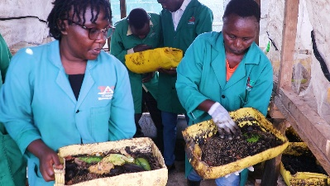
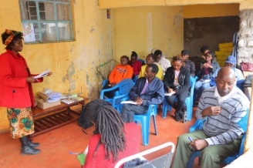
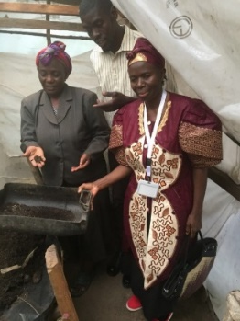
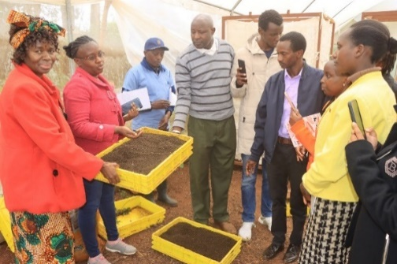
Objective 2 Outputs
2.1 Trained and sensitized 50 ToTs & 300 farmers on BSF Frass in Kakamega & Kiambu Counties | 2.1 List of trained ToTs & farmers
2.2 Set up demonstrations (10m x 10m) in FFS in Kiambu and Kakamega on farmers seed and new variety tests for African nightshade and Jute mallow using Frass fertilizer Renovated /set up BSF systems in FFS in 2 counties | 2.2 Activity based reports Field set up and design BSF systems on the FFS
2.3 Monitored and collected data on use of Frass fertilizer and other | 2.3 Activity based reports and FFS record book

Slide 18
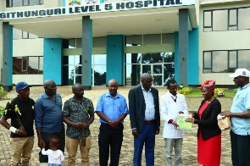
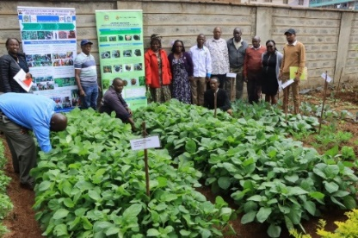
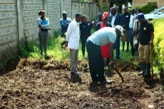
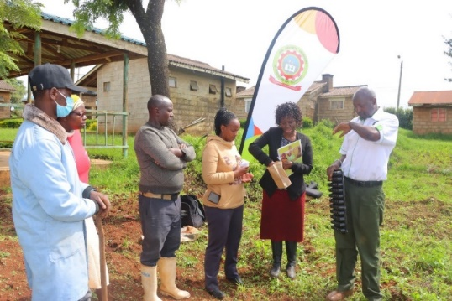
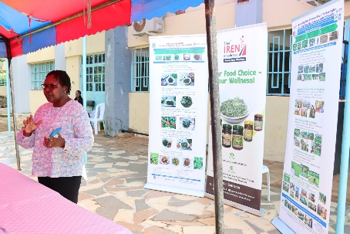
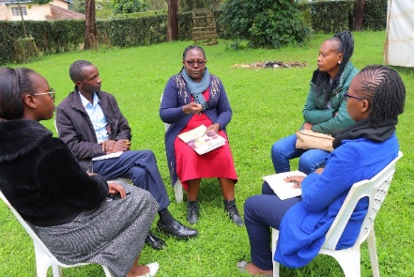
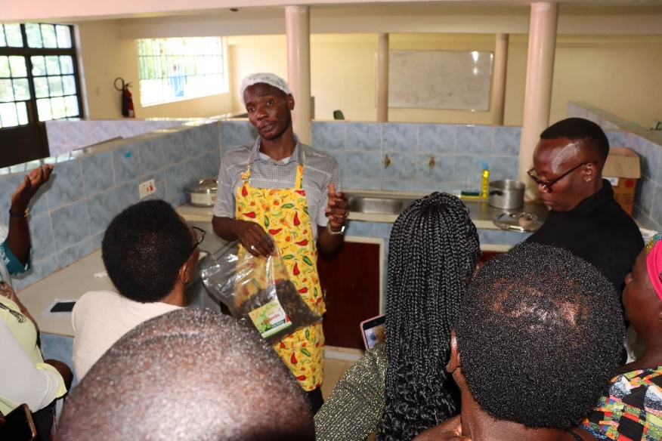
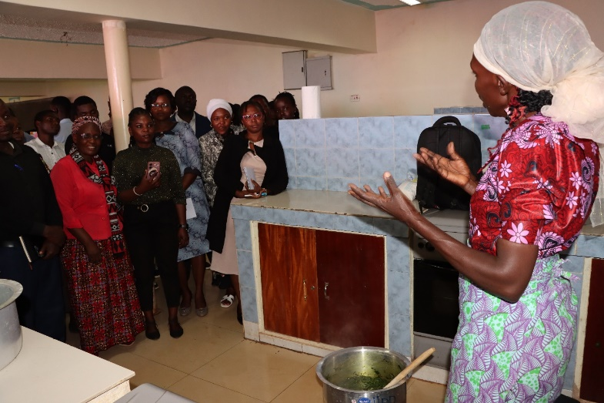
Objective 3 Outputs
3.1 Sensitized, trained & held cooking demos with standardized recipes to 200 participants from restaurants, hospitals, schools &Universities in Kakamega & Kiambu counties | 3.1 Activity based reports
3.2. Cooking demonstrations

Slide 19
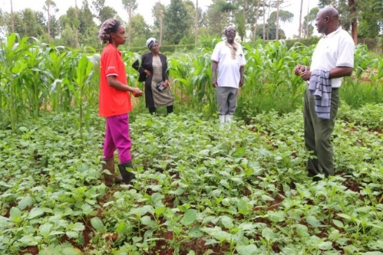
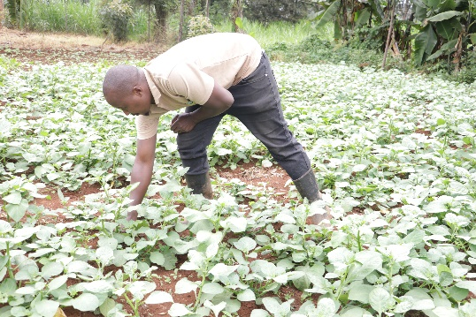
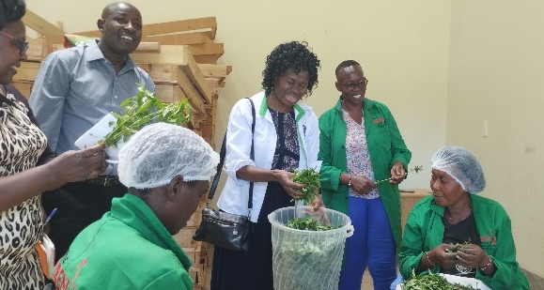
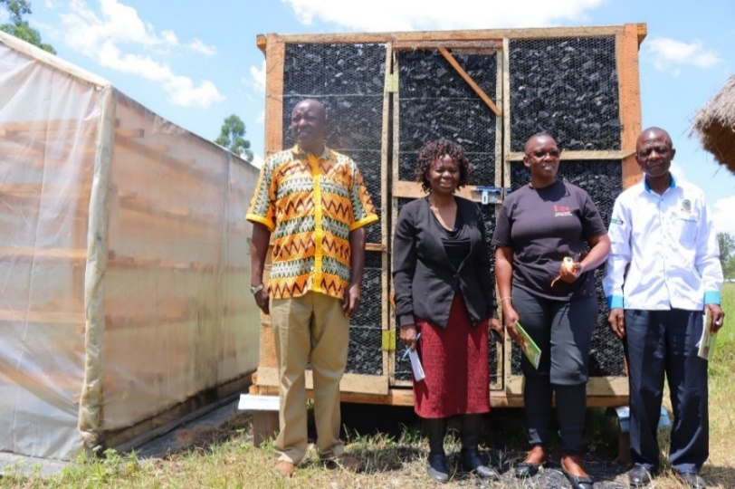
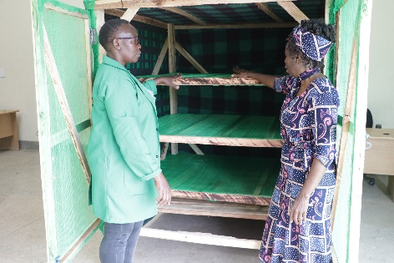
Objective 4 Outputs
4.1 Trained 300 farmers in commercial production of AIVs in Kakamega and Kiambu counties | 4.1 Activity based reports
4.2 Promoted commercial production in Kiambu and Kakamega counties at the FFS | 4.2 Sale records at the FFS Activity reports
4.3 Strengthened the existing aggregation centres by construction of Charcoal/Evaporative cooler in Kakamega county

Slide 20
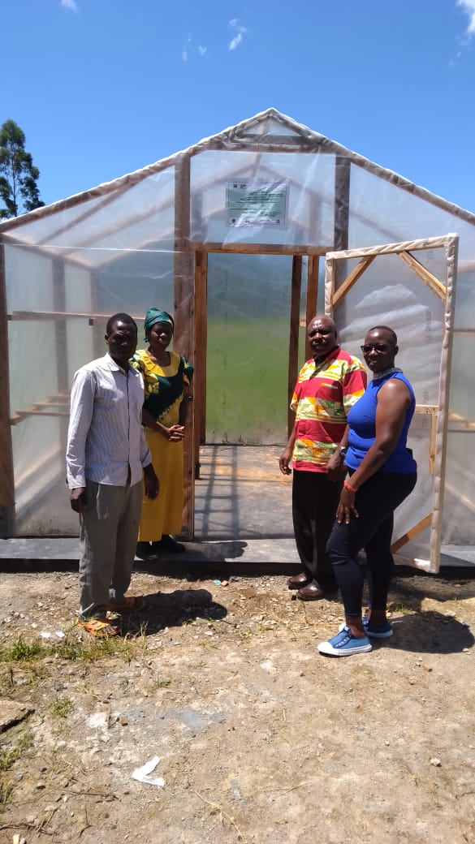
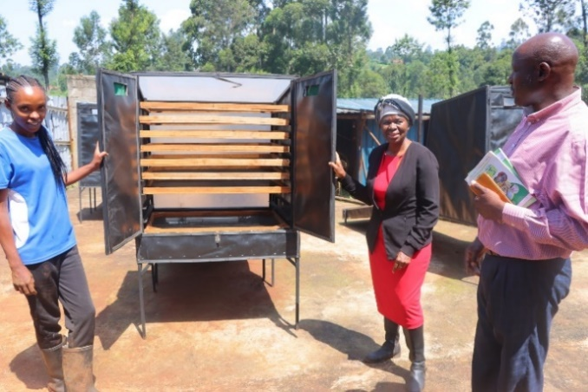
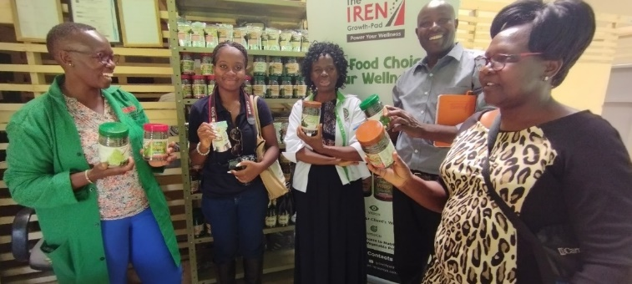
Objective 5 Outputs
5.1 Acquisition and installation of new solar dryer in Kakamega and refurbishment 4 small solar dryers in Kiambu 5.2 Trained 200 farmers of commercial production AIVs | 5.1 Activity based reports Solar dryer in Kakamega and Kiambu 5.2. Training manual

Slide 21
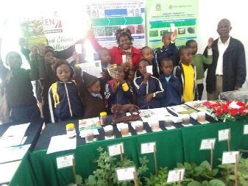
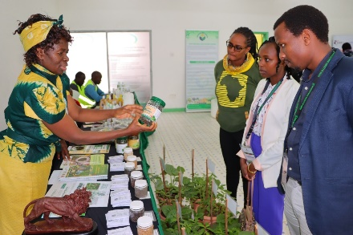
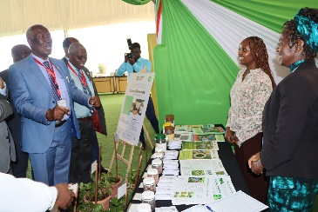
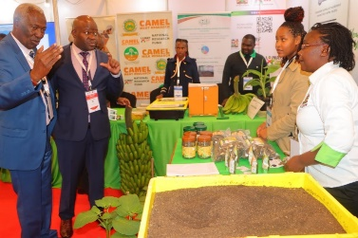
Objective 6 Outputs
6.1.1 identified information, repackaged and developed promotional materials | 6.1.1 Activity based reports Solar dryer in Githunguri and Shianda in place
6.1.4 Printed promotional materials | 6.1.4 Leaflets and posters
6.1.5 Distribution of promotional materials and submitted articles to media houses | 6.1.5 Distribution lists signing for materials
6.1.9 prepared 17 minutes project documentary 6.2 Drafts policy brief on production and recipes | 2 Policy briefs

Slide 22
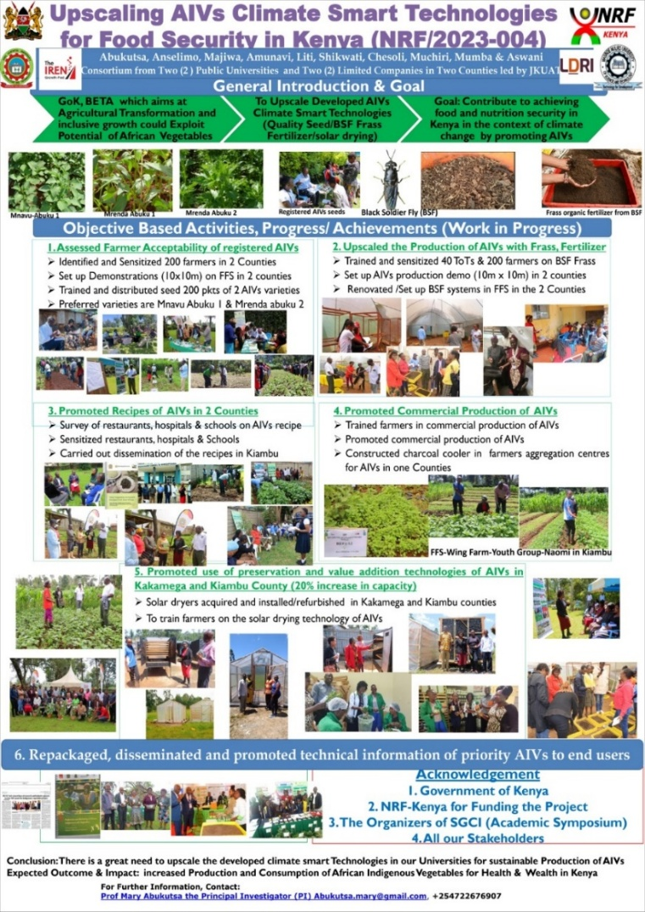
Objective 6 Outputs
NRF-Research Festival –August 2024, 2025
NITF – September 2024, 2025
Academic symposium –SGCI III-Nov 2024
JKUAT Conference March 2025
NACOSTI Multi-stakeholders conference 2025

Slide 23
Major Achievements
Established FFS & set up demos
Distributed 5,000 packets of AIVs
Trained 100 ToTs and 600 farmers (6,000)
Increased Production (2000 packets)
Upscaled the preservation and processing capacity of FFS by 60%
Dried and packaged AIVs for export in USA- potential in Middle East & Africa

Slide 24
Major Achievements
Kitchen garden (Githunguri Health C)
Disseminated AIVs information
Documentary and AIVs Song
Promotional
Drafted 2 Policy briefs
PI – AIVs Won NORA – National-2024
PI- AIVs-Won- AFP- - 2025

Slide 25

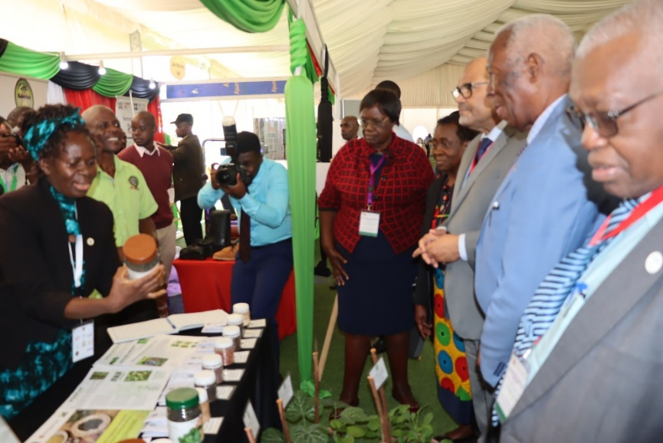
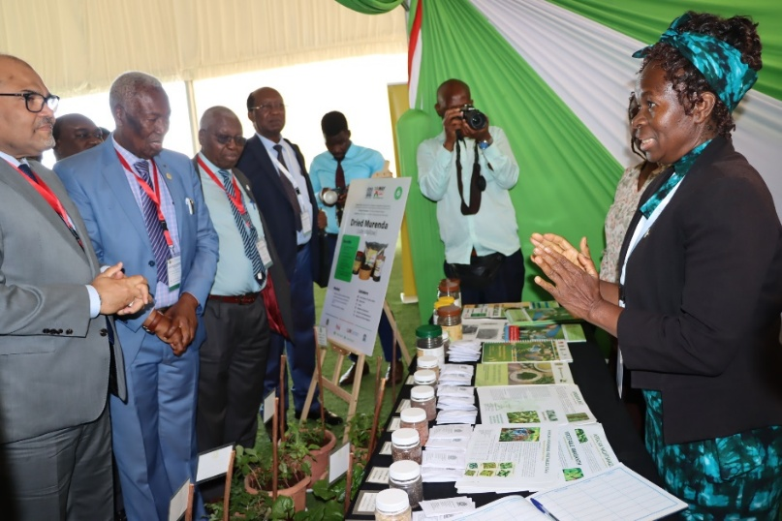
Policy makers interaction : Principal Secretary
What Quantities of AIVs are being produced & in which Counties?
a. Quantities= 300,000MT(2024) b. No of Counties 50% c. No of AIVs=8
2. What is the Current monetary value of AIVs realized in Kenya?
Kenya Shillings 10B, 95% Domestic market & 5% Export Market (0.5 B)
3. How can we ensure that AIVs & products are in all global markets?
This will form the major part of the AIVs Upscaling Handshake
IREN Growth Pad Ltd currently exports to USA on order basis

Slide 26
Future outlook & Sustainability
Agriculture being a devolved function more Counties will be encouraged to include African Indigenous Vegetables value chains in their development plans
Kenyan National African Leafy Vegetables (ALVs) Value Chain Development Strategy, the first of its kind was launched in 2024 with input from 3 members.
African vegetable biodiversity strategy Rescue plan 2025-2035 was launched in Kigali in 2024 and involves using vegetable genetic resources for improved health, income and climate resilience, Collaboration and partnership with the World Vegetable Centre would ensure sustainability (AFP)

Slide 27

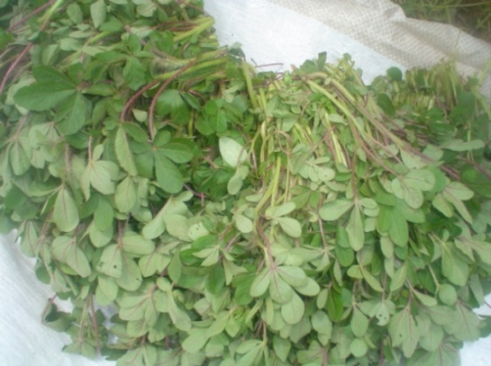

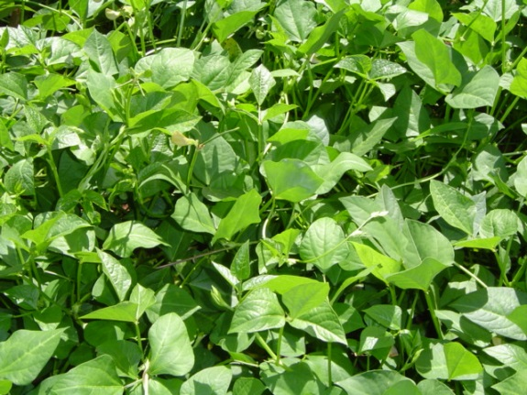
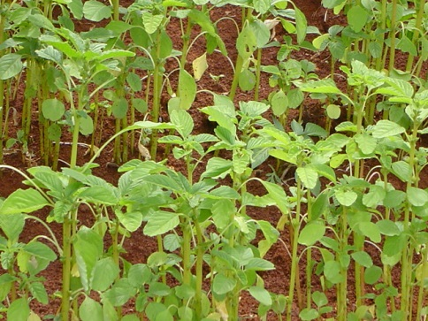
Major Constraints
Spiderplant-
Low adoption of developed technologies
Negative Mindset
&
Ignorance
Need to simplify and communicate effectively
Demand for AiVs in the domestic & Export market
High farmer expectations
Mathematical errors in the approve budget
Public and private sector disparities
Finance and procurement procedures
Other competing responsibilities & Unexpected occurrences
African (black) Nightshade
Vegetable Amaranth
Pigweed
Vegetable Cowpea

Slide 28
Work Progress
Implementation – Nov, 24 –June 25
Activities accomplished (90%)
Total money for the project and Disbursed (KES 15,000,000/=)
Money used so far: as at 26-11-2025 (90%)
10% to be used November/December 25
Expected date of completion 31st December 2025

Slide 29
Work in Progress

Slide 30
THANK YOU

